Slide 1
Kiosk PUMA Python Training Robot Base
Ralf Wang

Slide 2
介绍
介绍
安装
库
编辑器
实例
Unrestricted Internal Use
© Carestream Health, 2018

Slide 3
介绍
Robot Framework是一款python编写的功能自动化测试软件框架。具备良好的可扩展性，支持关键字驱动，可以同时测试多种类型的客户端或者接口，可以进行分布式测试执行。主要用于重复性的回归测试以及验收测试驱动开发，同时还可以支持行为驱动开发。 维基百科
许可协议： Apache License 2.0
编写语言： Python
开发者： Pekka Klärck, Janne Härkönen et al
首发时间： 2.0 June 24, 2008
稳定版发布时间： 3.1.2 / 2019 年 5 月 24 日
官方网站： https://robotframework.org/#/
Unrestricted Internal Use
© Carestream Health, 2018

Slide 4
Install
首先需要我们在系统中安装Python环境，并且确认PIP已经安装
方式一：
可以通过pip进行安装
pip install robotframework
安装完毕后需要安装一个ride的编辑器：
pip install robotframework-ride
安装完毕后通过命令来启动ride
执行Python安装路径\Scripts\ride.py文件 启动RIDE

Slide 5
Install
首先需要我们在系统中安装Python环境，并且确认PIP已经安装
方式二：
现在也可以通过直接安装ride，来完成整个过程：
pip install robotframework-ride
然后运行 Python安装路径、Scripts\ride.py文件 启动Ride
教程：
https://www.cnblogs.com/fnng/p/10363371.html

Slide 6
库
Robot Framework 自身带有一些库，方便脚本开发主要有：
Builtin Provides a set of often needed generic keywords. Always automatically available without imports.
Dialogs Provides means for pausing the test execution and getting input from users.
Collections
Provides a set of keywords for handling Python lists and dictionaries.
OperatingSystem
Enables various operating system related tasks to be performed in the system where Robot Framework is running.
Remote
Special library acting as a proxy between Robot Framework and test libraries elsewhere. Actual test libraries can be running on different machines and be implemented using any programming language supporting XML-RPC protocol.
Screenshot
Provides keywords to capture screenshots of the desktop.
String
Library for generating, modifying and verifying strings.
Telnet
Makes it possible to connect to Telnet servers and execute commands on the opened connections.
XML Library for generating, modifying and verifying XML files.
Process Library for running processes in the system. New in Robot Framework 2.8.
DateTime Library for date and time conversions. New in Robot Framework 2.8.5.
Unrestricted Internal Use
© Carestream Health, 2018

Slide 7
库
Robot Framework 第三方的库
Android library
AnywhereLibrary
AppiumLibrary
Archive library
AutoItLibrary
CncLibrary
ConfluentKafkaLibrary
CURFLibrary
Database Library (Java)
Database Library (Python)
DataDriver Library
Debug Library
Diff Library
Django Library
Eclipse Library
robotframework-faker
FTP library
HTTP library (livetest)
HTTP library (Requests)
HttpRequestLibrary (Java)
iOS library
太多了一页写不下： https://robotframework.org/#/libraries
Unrestricted Internal Use
© Carestream Health, 2018

Slide 8
编辑器
Robot的支持的编辑器也比较多：
RIDEStandalone Robot Framework test data editor.
Atom pluginRobot Framework plugin for Atom.
Brackets pluginRobot Framework plugin for Brackets.
Eclipse pluginRobot Framework plugin for Eclipse IDE.
Emacs major modeEmacs major mode for editing tests.
GeditSyntax highlighting for Gedit.
Robot Plugin for IntelliJ IDEAFor IntelliJ IDEA-based editors by JIVE Software.
Robot Support for IntelliJ IDEAFor IntelliJ IDEA-based editors by Valerio Angelini.
Notepad++Syntax highlighting for Notepad++.
REDEclipse based editor with a debugger by Nokia.
TextMate bundleBundle for TextMate adding syntax highlighting.
Sublime assistantA plugin for Sublime Text 2 & 3 by Andriy Hrytskiv.
Sublime pluginA plugin for Sublime Text 2 by Mike Gershunovsky.
Vim pluginVim plugin for development with Robot Framework.
Intellisense for Visual Studio CodeA Visual Studio Code extension that supports Robot Framework development.
Debugger for Visual Studio CodeA Visual Studio Code extension that lets you debug robot files with call stack, breakpoints, etc.
我们当前环境，建议使用ride来进行用例的设计
Unrestricted Internal Use
© Carestream Health, 2018

Slide 9
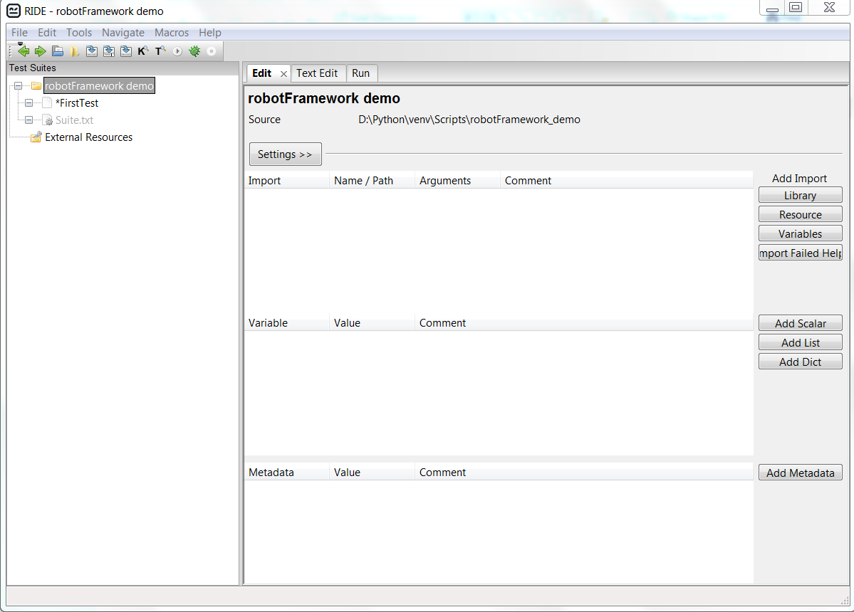
Ride
Unrestricted Internal Use
© Carestream Health, 2018

Slide 10
Ride
接下来，我们来介绍Ride的简单使用：
如何新建一个工程，测试套件。
怎样查看关键字
并设计一个用例输出 hello word 字符
判断用例执行是否错误
查看测试结果和日志
Unrestricted Internal Use
© Carestream Health, 2018

Slide 11

Q&A
Unrestricted Internal Use
© Carestream Health, 2018

